Slide 1
AIM5011: Leveraging NLP techniques in healthcare domain for processing of medical transcriptions
Group 5:
Lakshmikar Reddy Polamreddy
Harsha Koduri
Sai Kumar Kalisetty
Thirupathi Kadari

Slide 2


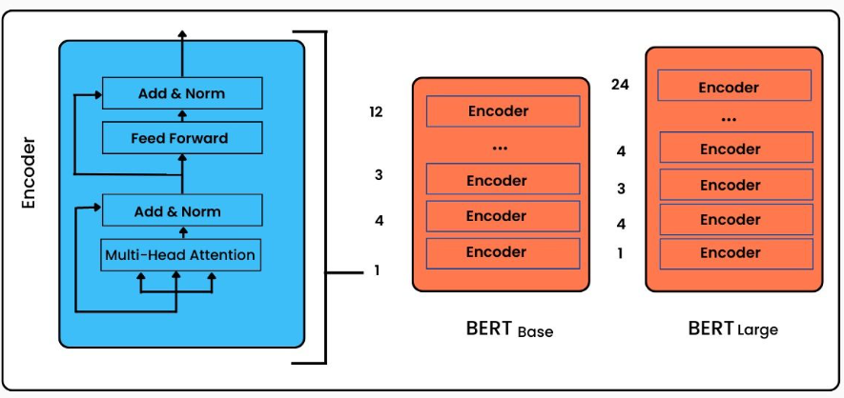

Overview
Motivation:
Availability of enormous amount of biomedical literature has generated deep interest to extract useful information and insights from text data. But the unstructured text data in medical documents makes this task hard.
Project Objectives:
To extract the drugs and their doses from patient's digital medical transcriptions – can be used for further analysis
To classify the medical specialties(clinical domains) based on patient's medical transcriptions – to automatically predict the initial diagnostics needed for the patient
To provide a web user interface by deploying the model on Hugging Face.
Data source:
https://mtsamples.com/
Deployment:
Hugging Face
Extracting drug names and their doses:
SpaCy library – NER models
Multi-class text classification:
Bert model (plus comparison with other models)

Slide 3

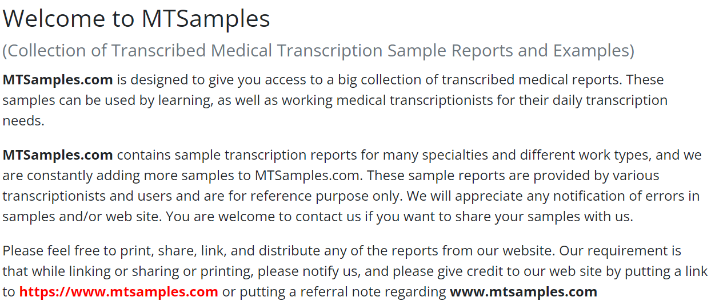
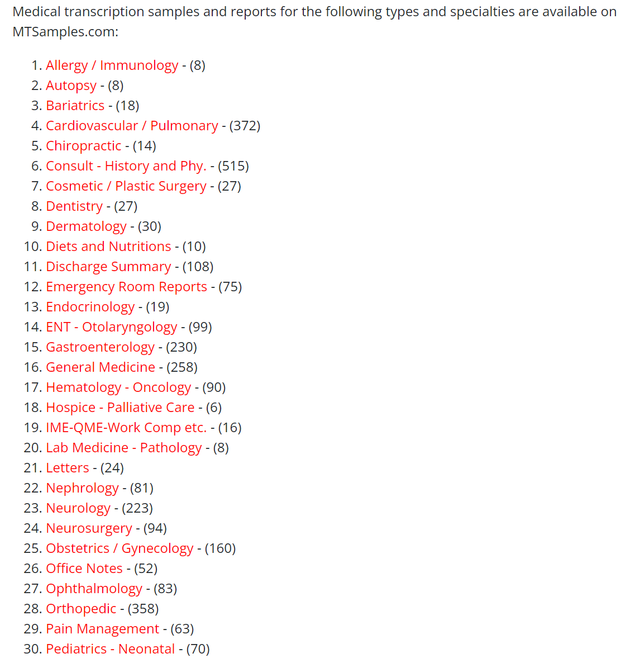
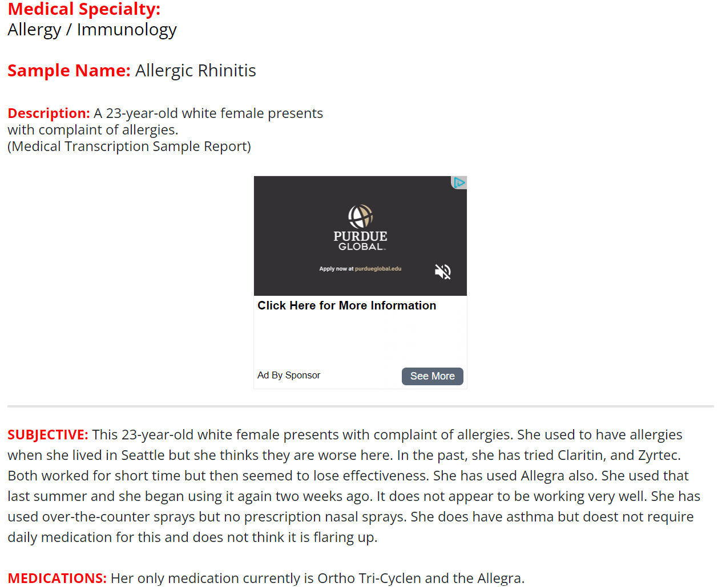
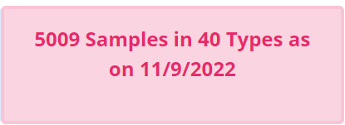
Dataset summary
Dataset Summary
Source of Information | https://mtsamples.com/
Number of samples | 5009
Types(medical specialty) | 40
Data type | Text data
Descriptive Statistics

Slide 4
Team Responsibilities
GROUP 5
Lakshmikar Polamreddy
Harsha Koduri
Sai Kumar Kalisetty
Tirupati Kadari
Project management and planning
Project Proposal
Model building
Writing research paper
Slide deck for final presentation
Data collection and data scraping
Model building and tuning
Model deployment
User Interface
Data collection and data scraping
Data pre-processing
Model building
Research paper
Data pre-processing
Model validation
Writing research paper
Slide deck for final presentation

Slide 5





Project Milestones & Timeline
07-03-2023
07-31-2023
Planning
Present project proposal
Collect required datasets
Assign roles and responsibilities with due dates
Model building
Build NER model for extracting entities
Build models for text classification
Deliver & Present
Write a research paper
Present final solution to class
Data collection and Pre-processing
Scrape data from the website
Pre-process the data
Handle data imbalance
Validation and Deployment
Test the model and finetune it
Deploy the model on Hugging Face
Create user interface
06-26-2023
07-24-2023
08-07-2023

Slide 6
Thank you!

